Slide 1
Natural Language Tool-Kit (NLTK)
Amos Azaria

Slide 2
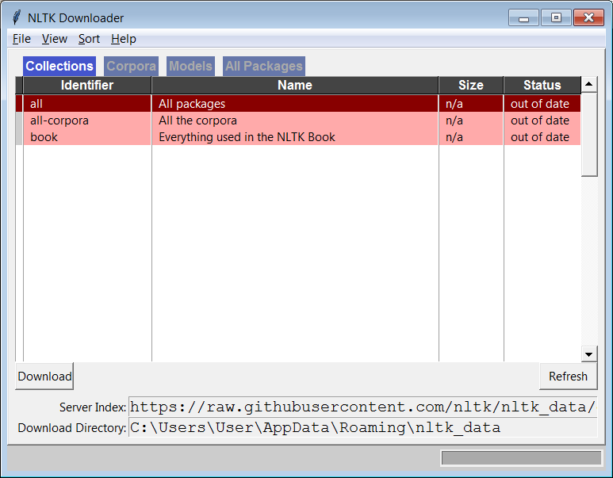
NLTK
Natural Language Tool-Kit: tokenization, stemming, POS, preprocessing in general…
pip install nltk
nltk.download()
NLTK is in English. It has some limited support for other languages such as French, Spanish, German and more, but not for Hebrew.
Here is a link for some Hebrew NLP (not using NLTK): https://github.com/iddoberger/awesome-hebrew-nlp
Notes:
pip is likely already installed, if not dowload and install it.
nltk.download('punkt')
nltk.download('all')
החיתוך הרגיל בדרך כלל עם רווח אבל זה לא מספיק טוב

Slide 3
Tokenization
When we process sentences, the most basic operation we usually do is tokenization: split a sentence to tokens (words).
E.g.:
Natural language processing.
Time for a break, it's 7 o'clock!
Ask Mr. Cohen for help!
Many times we also want to split a document into sentences.
E.g.:
Where did Mrs. Levi go? I'm looking for her.
Can we just split on spaces?
The period is not a part of the word
it's is actually two tokens (it 's) while o'clock is one.
In Mr. the period is a part of the word
Can we just split on periods? What about question and exclamation marks?

Slide 4
Tokenization in NLTK
>>> my_text = "Where is St. Paul located? I don't seem to find it. It isn't in my map."
>>> my_text.split(" ") # or my_text.split()
['Where', 'is', 'St.', 'Paul', 'located?', 'I', "don't", 'seem', 'to', 'find', '
it.', 'It', "isn't", 'in', 'my', 'map.']
>>> import nltk
>>> from nltk.tokenize import word_tokenize, sent_tokenize
>>> word_tokenize(my_text)
['Where', 'is', 'St.', 'Paul', 'located', '?', 'I', 'do', "n't", 'seem', 'to', 'find', 'it', '.', 'It', 'is', "n't", 'in', 'my', 'map', '.']
>>> sent_tokenize(my_text)
['Where is St. Paul located?', "I don't seem to find it.", "It isn't in my map."]
Notes:
Recall our search.py from previous lesson.
כדאי להשתמש בTOKENIZATION ולא להשתמש בSPLIT

Slide 5
Stemming
Many times we want to treat close words as identical, for example, when we run a search query.
The words: "walking, walk, walks" can be all stemmed to: "walk". House, houses, housing, can be all stemmed to hous (which is not a word).
We must first tokenize the sentence before we can stem the words in it (since the stemmers work on each word separately).
There exist several stemming algorithms:
from nltk.stem.porter import PorterStemmer
from nltk.stem.lancaster import LancasterStemmer
from nltk.stem import SnowballStemmer

Slide 6
Stemming in NLTK
>>> from nltk.stem import PorterStemmer
>>> from nltk.tokenize import word_tokenize
>>> ps = PorterStemmer()
>>> my_text = “Many smart students are sitting here."
>>> stemmed_sentence = []
>>> for word in word_tokenize(my_text):
... stemmed_sentence.append(ps.stem(word))
>>> stemmed_sentence
['mani', 'smart', 'student', 'are', 'sit', 'here', '.']
>>> ps.stem("fdskjhnating")
'fdskjhnate'

Slide 7
Part of Speech Tagging (POS)
Part of speech is a category assigned to words based on their syntactic function.
E.g.:
Noun: boy, John, birthday
Verb: went, ate, is
Pronoun: it, she, ours
Adjective: big, smart, five
Adverb: well, quickly
Determiner: the, an, this, few
Preposition: over, to, at
Conjunction: and, or, but
Interjection: Hurray!
When processing natural language, knowing the part of speech part is often very useful.
E.g.:
I saw the show
Show me where to go

Slide 8
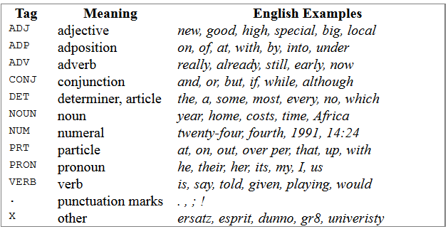
POS Tagging in NLTK (Penn TreeBank)
CC - Coordinating conjunction
CD - Cardinal number
DT - Determiner
EX - Existential there
FW - Foreign word
IN - Preposition or subordinating conjunction
JJ - Adjective
JJR - Adjective, comparative
JJS - Adjective, superlative
LS - List item marker
MD - Modal
NN - Noun, singular or mass
NNS - Noun, plural
NNP - Proper noun, singular
NNPS - Proper noun, plural
PDT - Predeterminer
POS - Possessive ending
PRP - Persol pronoun
PRP$ - Possessive pronoun (prolog version PRP-S)
RB - Adverb
RBR - Adverb, comparative
RBS - Adverb, superlative
RP - Particle
SYM - Symbol
TO - to
UH - Interjection
VB - Verb, base form
VBD - Verb, past tense
VBG - Verb, gerund or present participle
VBN - Verb, past participle
VBP - Verb, non-3rd person singular present
VBZ - Verb, 3rd person singular present
WDT - Wh-determiner
WP - Wh-pronoun
WP$ - Possessive wh-pronoun (prolog version WP-S)
WRB - Wh-adverb
>>> my_tokenized_text = word_tokenize(my_text)
>>> nltk.pos_tag(my_tokenized_text)
[('many', 'JJ'), ('smart', 'JJ'), ('students', 'NNS'), ('are', 'VBP'), ('sitting', 'VBG'), ('here', 'RB'), ('.', '.')]
>>>nltk.help.upenn_tagset()
Notes:
Part of speech e.g.: nouns, pronouns, articles, adjectives, verbs, adverbs, conjunctions and prepositions
(not to be confused with part of sentence: subject, predicate, objects, complements, phrases and clauses)

Slide 9
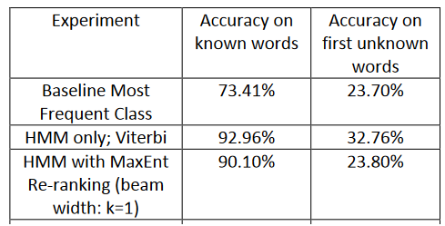
POS tagging algorithms
MLP with neural character embeddings (CharWNN) | 97.32% | 89.86%
https://nlp.stanford.edu/courses/cs224n/2011/reports/highfill.pdf
http://proceedings.mlr.press/v32/santos14.html
Notes:
According to: https://stackoverflow.com/questions/32016545/how-does-nltk-pos-tag-work/41384824 nltk uses perceptron tagger.

Slide 10
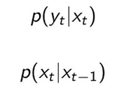
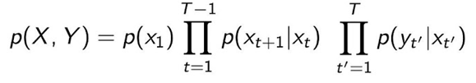
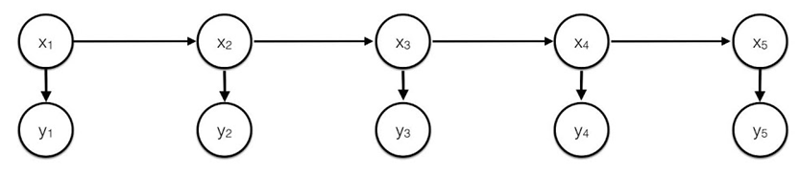
POS – Hidden Markov Model
V
observation prob. (emitted words)
transition prob. (POS)
0.6
0.1
END
N
0.2
0.1
1
0.1
ST
D
0.05
0.4
show
0.6
Jessica
<END>
the
Start
Noun
Verb
Det
Noun
<Start>
Jessica
watched
the
show
Notes:
https://www.mygreatlearning.com/blog/pos-tagging/

Slide 11
POS – Viterbi Algorithm
Given a sentence we want to know what the most likely POS tags are.
Assume the following sentence: “the dog walked in the park”
We use dynamic programming.

Slide 12
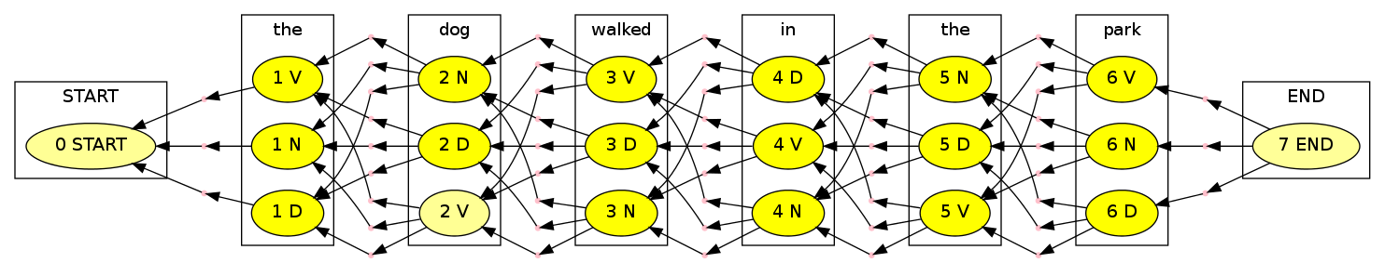
POS - Viterbi Algorithm
V
0.6
0.1
END
Transition | D | END | N | START | V
D | 0.1 | 0 | 0.1 | 0.4 | 0.4
END | 0 | 1 | 0.2 | 0 | 0.1
N | 0.8 | 0 | 0.1 | 0.3 | 0.3
V | 0.1 | 0 | 0.6 | 0.3 | 0.2
N
0.1
1
0.1
ST
D
0.8
0.4
Emission | D | END | N | START | V
<END> | 0 | 1 | 0 | 0 | 0
<START> | 0 | 0 | 0 | 1 | 0
dog | 0.1 | 0 | 0.8 | 0 | 0.05
in | 0.3 | 0 | 0 | 0 | 0
park | 0 | 0 | 0.1 | 0 | 0.1
the | 0.6 | 0 | 0.1 | 0 | 0.05
walked | 0 | 0 | 0 | 0 | 0.8
park
0.6
0.0036
dog
<END>
0.0024
the
0.1536
0. 015
0.3
0.8
0.05
0.1
0.3
0.03
0.8
0.3
0.1
0.4
0.24
0.6
Every node holds the most probable path up-to it.
Complexity?
k²T
https://pydecode.readthedocs.io/en/latest/notebooks/hmm.html
Notes:
POS (Part-of-Speech) tagging with Hidden Markov Model | Great Learning (mygreatlearning.com)

Slide 13
Lemmatization
Lemmatization is very similar to stemming but is more complex (heavier, slower but better results).
A Lemmitizer is "familiar" with the words, so words like "going" and "went" are lemitized to the same lemma: "go".
A Lemmitizer must know the POS of the word in order to lemmatize it.
The WordNetLemmatizer in NLTK uses a shorter list of part of speech tags than the Penn TreeBank, (so we use a short function to make the conversion).

Slide 14
Lemmatization in NLTK
from nltk.corpus import wordnet as wn
def is_noun(tag):
return tag in ['NN', 'NNS', 'NNP', 'NNPS']
def is_verb(tag):
return tag in ['VB', 'VBD', 'VBG', 'VBN', 'VBP', 'VBZ']
def is_adverb(tag):
return tag in ['RB', 'RBR', 'RBS']
def is_adjective(tag):
return tag in ['JJ', 'JJR', 'JJS']
def penn2wn(tag):
if is_adjective(tag):
return wn.ADJ
elif is_noun(tag):
return wn.NOUN
elif is_adverb(tag):
return wn.ADV
elif is_verb(tag):
return wn.VERB
return wn.NOUN
from: http://stackoverflow.com/questions/25534214/nltk-wordnet-lemmatizer-shouldnt-it-lemmatize-all-inflections-of-a-word
Notes:
כמו שורש בעברית

Slide 15
Lemmatization in NLTK
from nltk.tokenize import word_tokenize
from nltk import pos_tag
from nltk.stem.wordnet import WordNetLemmatizer
lzr = WordNetLemmatizer()
my_text = “Many smart students are sitting here."
lemed = []
for (word,pos) in pos_tag(word_tokenize(my_text)):
lemed.append(lzr.lemmatize(word,penn2wn(pos)))
>>> lemed
['many', 'smart', 'student', 'be', 'sit', 'here', '.']
Notes:
כמו שורש בעברית

Slide 16
Chunking
Chunking is a method to chunk a sentence (or a set of sentences), into different chunks (groups).
Chunking uses regular expressions (templates) on the parts of speech.
E.g.:
NP: {<DT>?<JJ>*<NN>} : a chunk (noun phrase) is composed of an optional determiner, zero or more adjectives and a noun. E.g.: "The nice big boy"
NounList: {(<DT>?<NN.?><,>?)+<CC><DT>?<NN.?>} :
<NN.?>* = one or more of different types of nouns, with an optional determiner before and an optional comma after (.? Means that there can be another character here: NN, NNP, NNS)
<CC> = Coordination conjunction
E.g.:
"Sara, John, Tom, the girl and the bat"
"Dogs or cats"
Notes:
Chunk: {<RB.?>*<VB.?>*<NNP>+<NN>?}:
<RB.?>* = 0 or more of any tense of adverb, (.? Means that there can be another character here: RB, RBR, RBS)
<VB.?>* = 0 or more of any tense of verb,
<NNP>+ = One or more proper nouns,
<NN>? = zero or one singular noun.
https://pythonprogramming.net/chunking-nltk-tutorial/

Slide 17
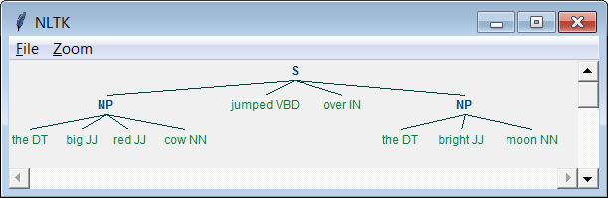
Chunking in NLTK
>>> my_text = "the big red cow jumped over the bright moon"
>>> tagged = nltk.pos_tag(nltk.tokenize.word_tokenize(my_text))
>>> grammar = "NP: {<DT>?<JJ>*<NN>}"
>>> cp = nltk.RegexpParser(grammar)
>>> result = cp.parse(tagged)
>>> print(result)
(S
(NP the/DT big/JJ red/JJ cow/NN)
jumped/VBD
over/IN
(NP the/DT bright/JJ moon/NN))
>>> result.draw()

Slide 18
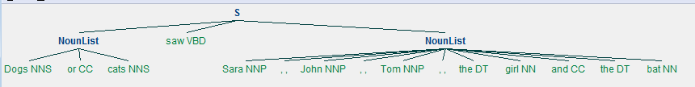
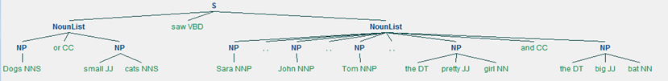
Chunking (Additional examples)
my_text = "Dogs or cats saw Sara, John, Tom, the girl and the bat"
grammar = "NounList: {(<DT>?<NN.?><,>?)+<CC><DT>?<NN.?>}"
my_text = "Dogs or small cats saw Sara, John, Tom, the pretty girl and the big bat"
grammar = """NP: {<DT>?<JJ>*<NN.?>}
NounList: {(<NP><,>?)+<CC><NP>}"""

Slide 19
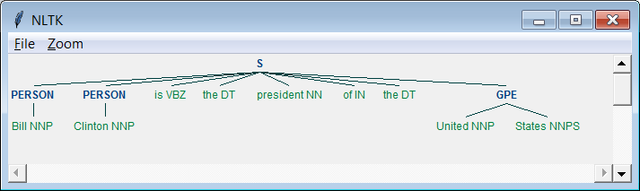
Named Entity Recognition (NER)
>>> result = nltk.ne_chunk(nltk.pos_tag(nltk.word_tokenize("Bill Clinton is the president of the United States")))
>>> print (result)
(S
(PERSON Bill/NNP)
(PERSON Clinton/NNP)
is/VBZ
the/DT
president/NN
of/IN
the/DT
(GPE United/NNP States/NNPS))
>>> result.draw()
geo = Geographical Entity
org = Organization
per = Person
gpe = Geopolitical Entity
tim = Time indicator
art = Artifact
eve = Event
nat = Natural Phenomenon

Slide 20
Bi-Grams
In natural language processing, we many times are interested in the appearances of pairs of words (bi-grams).
For example, for the following sentence:
"I did it you did it you did it"
We get the following bi-grams count:
[((I, did), 1), ((did, it), 3), ((it, you), 2), ((you, did), 2)]
This is useful for part of speech tagging, feature extraction, story generation, etc.
Tri-grams are the same with triples, and in general, we call these sequences n-grams.

Slide 21
N-Grams
>>> text = "It is a simple text this, this is a simple text, is it simple?"
>>> list(nltk.ngrams(nltk.word_tokenize(text),3))
[('It', 'is', 'a'), ('is', 'a', 'simple'), ('a', 'simple', 'text'), ('simple', 'text', 'this'), ('text', 'this', ','), ('this', ',', 'this'), (',', 'this', 'is'), ('this', 'is', 'a'), ('is', 'a', 'simple'), ('a', 'simple', 'text'), ('simple', 'text', ','), ('text', ',', 'is'), (',', 'is', 'it'), ('is', 'it', 'simple'), ('it', 'simple', '?')]

Slide 22
N-Grams – Text Generation
Given text data, we would like to generate new text which would look similar to the given text.
Auto completion, predicting next words when writing
Games and entertainment
We will use the following algorithm:
Split the data into tri-grams.
Start with two words, then every time sample the next word, given the previous two words, according to the data distribution.

Slide 23
N-Grams (Cont.)
import nltk
import urllib
from random import randint
paragraph_len = 100
all_text = urllib.request.urlopen("https://s3.amazonaws.com/text-datasets/nietzsche.txt").read().decode("utf-8") #for Python 2 remove "request"
tokens = nltk.word_tokenize(all_text)
my_grams = list(nltk.ngrams(tokens,3))
sentence = ["It", "is"]
for i in range(paragraph_len):
options = []
for trig in my_grams:
if trig[0].lower() == sentence[len(sentence)-2].lower() and trig[1].lower() == sentence[len(sentence)-1].lower():
options.append(trig[2])
if len(options) > 0:
sentence.append(options[randint(0, len(options)-1)])
print(" ".join(sentence))

Slide 24
Running Example
C:\>python text_generator.py
It is a categorical imperative but to a stronger one may place oneself nowadays , throughout almost the opposite : there are certain insipid , traffic-virtuous people to pose , and turning thereof , is shown by children and childish , light-minded toleration , on the other hand , gait , face , changed ? And our silence , at the very opposite realises itself with all our senses learn late , very human -- all-too-human facts . It is impossible for a phantom of disbelief , which are not the case of priests who , owing to the point of Honor

Slide 25
Context Free-Grammar (CFG)
As you have learned in Automatons and Formal Languages. CFG are composed of four components:
T: terminal vocabulary (the words of the language being defined)
V: non-terminal vocabulary
P: a set of productions of the form a -> b, (a is a non-terminal and b is a sequence of one or more symbols from T U V)
S: the start symbol (member of V)

Slide 26
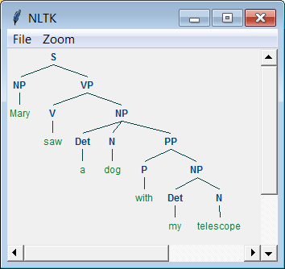
CFG Parser
>>> grammar1 = nltk.CFG.fromstring("""
S -> NP VP
VP -> V NP | V NP PP
PP -> P NP
V -> "saw" | "ate" | "walked"
NP -> "John" | "Mary" | "Bob" | Det N | Det N PP
Det -> "a" | "an" | "the" | "my"
N -> "man" | "dog" | "cat" | "telescope" | "park"
P -> "in" | "on" | "by" | "with" """)
>>> sentence = "Mary saw Bob".split()
>>> rd_parser = nltk.RecursiveDescentParser(grammar1)
>>> print(list(rd_parser.parse(sentence))[0])
(S (NP Mary) (VP (V saw) (NP Bob)))
>>>print(list(rd_parser.parse("Mary saw a dog with my telescope".split()))[0])
(S (NP Mary) (VP (V saw)
(NP (Det a) (N dog) (PP (P with) (NP (Det my) (N telescope))))))
>>>(list(rd_parser.parse("Mary saw a dog with my telescope".split()))[0]).draw()

Slide 27
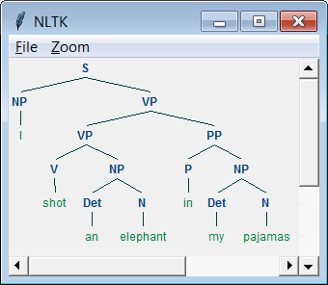
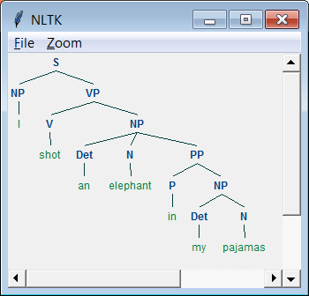
Ambiguity with CFG
>>> groucho_grammar = nltk.CFG.fromstring("""
... S -> NP VP
... PP -> P NP
... NP -> Det N | Det N PP | 'I'
... VP -> V NP | VP PP
... Det -> 'an' | 'my'
... N -> 'elephant' | 'pajamas'
... V -> 'shot'
... P -> 'in'
... """)
>>> sent = ['I', 'shot', 'an', 'elephant', 'in', 'my', 'pajamas']
>>> parser = nltk.ChartParser(groucho_grammar)
>>> for tree in parser.parse(sent):
... print(tree) #tree.draw()
From: http://www.nltk.org/book/ch08.html

Slide 28
CYK Algorithm
The CYK algorithm which uses dynamic programing is used in order to find a tree (a constituency parse)
Complexity of the CYK is O(n³ |G|), where n is the length of the sentence, and G is the grammar size.
Notes:
Cocke–Younger–Kasami

Slide 29
CYK
The CYK is used to find a parse tree in a context free grammar.
Before we can run the algorithm, we need to convert all the grammar to Chomsky normal form (CNF).
This conversion does not change the strings that can be reached with the grammar.

Slide 30
Chomsky Normal Form (CNF)
In Chomsky normal form, all production rules are either from a nonterminal symbol to a (single) terminal symbol, or from a nonterminal symbol to 2 nonterminal symbols. That is:
A → BC (A → AB etc. is also ok)
A → a
(or S → ε, where ε is the empty sentence)
The start symbol must only appear on the left.

Slide 31
Converting a Grammar to CNF
Change all occurrences of S to S₁ and add the following rule:
S → S₁
2) Create a special rule for any terminal on the right, and use the nonterminal instead. E.g. A → BcD :
C_{t} → c
3) Eliminate rules with more than 2 non-terminals on right. E.g. A → BCD… :
A → BA₁
A₁ → CA₂
…
4) Eliminate ε rules and unit rules (not too complex, but won't be covered)

Slide 32
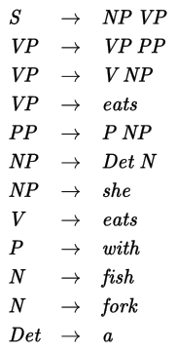
The CYK Algorithm
Suppose we have the following grammar:
We would like to determine whether the following sentence is in the grammar:
"she eats fish with a fork"
NP → fish
From Wikipedia

Slide 33
CYK Algorithm Example
Every entry in the table will hold all possible nonterminals that can derive the words underneath it.
NP --→ fish
she | eats | fish | with | a | fork
S
---
VP
---
---
---
S
---
---
PP
S
VP
---
---
NP
NP
V, VP
N,NP
P
Det
N

Slide 34
Parse Tree
In order to obtain the parse tree, every node must not only hold the non-terminals that can be used to derive the words, but also pointers to the sub-trees (i.e. the nodes below that were used to obtain the result).

Slide 35
Probabilistic Context Free Grammar (PCFG)
>>> grammar = nltk.PCFG.fromstring("""
S -> NP VP [1.0]
VP -> TV NP [0.4]
VP -> IV [0.3]
VP -> DatV NP NP [0.3]
TV -> 'saw' [1.0]
IV -> 'ate' [1.0]
DatV -> 'gave' [1.0]
NP -> 'telescopes' [0.8]
NP -> 'Jack' [0.2] """)
>>> viterbi_parser = nltk.ViterbiParser(grammar)
>>> for tree in viterbi_parser.parse(['Jack', 'saw', 'telescopes']):
... print(tree)
(S (NP Jack) (VP (TV saw) (NP telescopes))) (p=0.064)
Credit: http://www.nltk.org/book/ch08.html
Notes:
0.2*0.4*0.8

Slide 36
Probabilistic Context Free Grammar (PCFG)
>>> grammar = nltk.PCFG.fromstring("""
S -> NP VP [1.0]
VP -> VBP NP [0.50]
VP -> VBP NP PP [0.50]
TV -> 'saw' [1.0]
VBP -> 'ate' [1.0]
NP -> NP PP [0.3]
PP -> IN NP [1.0]
NP -> 'spaghetti' [0.2]
NP -> 'they' [0.3]
NP -> 'meatballs' [0.2]
IN -> 'with' [1.0]
""")
(S
(NP they)
(VP
(VBP ate)
(NP spaghetti)
(PP (IN with) (NP meatballs)))) (p=0.0108)
(S
(NP they)
(VP
(VBP ate)
(NP (NP spaghetti) (PP (IN with) (NP meatballs))))) (p=0.00288)

Slide 37
CoreNLP
CoreNLP is a stanford library that is written in Java but can be called by different programming languages including Python.
CoreNLP is more powerful than NLTK, and includes the following features, which we will examine next:
A large built-in grammar
Dependency Parsing
Coreference Resolution

Slide 38
Loading a Grammar
While we may sometimes want to create the grammar ourselves (for a specific domain), in many cases we want to load a grammar.
While NLTK comes with some grammar files (which can be obtained from nltk_data), these are rather small.
Fortunately, Stanford CoreNLP, can be used also via Python (see: https://github.com/dasmith/stanford-corenlp-python)

Slide 39

Dependency Parsing (CoreNLP)
Words are dependent of other head words.
Dependency parsing is much faster than constituency parsing.
Jumped=root
From: http://nlp.stanford.edu:8080/corenlp/process (CoreNLP demo)
from nltk.parse.stanford import StanfordDependencyParser
path_to_jar = 'path_to/stanford-parser-full-2014-08-27/stanford-parser.jar'
path_to_models_jar = 'path_to/stanford-parser-full-2014-08-27/stanford-parser- 3.4.1-models.jar'
dependency_parser = StanfordDependencyParser(path_to_jar=path_to_jar, path_to_models_jar=path_to_models_jar)
result = dependency_parser.raw_parse('I shot an elephant in my sleep')
dep = result.next()
list(dep.triples())
credit: http://stackoverflow.com/questions/7443330/how-do-i-do-dependency-parsing-in-nltk

Slide 40
Co-reference Resolution (CoreNLP)
"The bus was full. It drove very fast."
"Emma was happy. She didn't say a word."
"The cow ate a lot of grass. It was hungry."
"The cow ate a lot of grass. It was very green."
"Tom Cruise is an actor. Tom stars in many movies."
["John Mill Married Rachel. Mrs. Mill / John's wife was very smart."]
See http://stanfordnlp.github.io/CoreNLP/coref.html for usage example (in Java)

Slide 41
Combinatory Categorical Grammar (CCG) Parsing
CCG parsing can natural language to logical forms.
Words acts like functions, in which other words or part of sentences as arguments.
Parsing tokens derives both syntactic category and logical form.

Slide 42
CCG Parsing Example
set
the
subject
to
time to go
(setFieldFromString )
(getMutableFieldByFieldName subject)
(stringValue ”time to go”)
MutableField
FieldName
StringV
S
PP_StringV
Sentence | Logical Form
set the subject to time to go | (setFieldFromString (getMutableFieldByFieldName subject) (stringValue ”time to go”))
Token | Syntax | Semantics
set | ((S/PP_StringV)/MutableField) | (lambda x y (setFieldFromString x y))
to | PP_StringV/StringV | (lambda x x)
subject | FieldName | subject
Syntactic Input | Syntactic Output | Semantics
FieldName | MutableField | (lambda x (getMutableFieldByFieldName x))
any seq. | StringV | (lambda x (stringValue “x“))
Notes:
A CCG parser has a lexicon, in which each lexicon entry has a word which is associated with both a syntax and semantics.
explain how you read the syntax!
There also is a list of unary rules which can modify the syntax of a token, and have a syntactic input, syntactic output and the semantics associated with this operation.
The CCG parser also has the ability to skip (ignore) words.

Slide 43

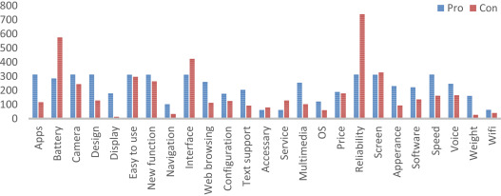
Sentiment Analysis
We many times want to know the sentiment of a sentence (is it positive or negative).
We may have many reviews on a camera, and would like to separate them to positive and negative.
Another example, we have many reviews on a phone, we may want to output the sentiment over each of its features.

Slide 44
Sentiment Analysis in NLTK
>>>from nltk.sentiment.vader import SentimentIntensityAnalyzer
>>>sna = SentimentIntensityAnalyzer()
>>> sna.polarity_scores("The movie was great!")
{'neu': 0.406, 'neg': 0.0, 'compound': 0.6588, 'pos': 0.594}
>>> sna.polarity_scores("I liked the book, especially the ending.")
{'neu': 0.641, 'neg': 0.0, 'compound': 0.4215, 'pos': 0.359}
>>> sna.polarity_scores("The staff were nice, but the food was terrible.")
{'neu': 0.536, 'neg': 0.318, 'compound': -0.5023, 'pos': 0.146}
Compound is a normalized value between -1 (negative) to +1 (positive).
Notes:
If we have more than a single sentence we should split it with the sentence tokenizer.

Slide 45
Sentiment Analysis – How?
Bag-of-words Naïve Bayes.
"it wasn't good, it was actually bad." = "it wasn't bad, it was actually good."
Combine negation with next word (e.g. "n't good", "not good", "n't bad").
"Most of the story was very good, though parts of it were not as good".
(not … good)
Very good > slightly good
Use bag of n-grams.
Other machine learning methods (e.g. deep learning, depending on the size of the data).

